Slide 1

Django Views
Function-based and
Class-based views
Program: EDGE-CSE CUET DIGITAL SKILLS TRAINING
Course: Python (Django) [Intermediate]
Lecture: Training Session-08 Date: 8th October, 2024 Duration: (1+1) hours
Instructor: Tanveer Rahman, Sr. Software Engineer, Friends Corp. Chuo-ku, Tokyo, JP shakil10vr@hotmail.com, 01626735005

Slide 2
Django Views
Views handle web requests and return responses.
Two main types of views in Django:
Function-based views (FBVs) Class-based views (CBVs)

Slide 3
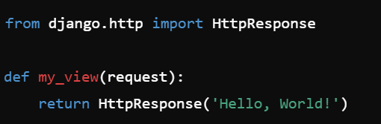
Function-Based Views (FBVs)
Definition
FBVs are Python functions that take web requests and return responses.
Example:
Use decorators to handle permissions, authentication, etc.
Advantages:
Simple and easy to implement. Ideal for small, straightforward logic.

Slide 4
Task 1: Create a Function-Based View (15 Mins)
Create a basic FBV to display "Welcome to Django!" on the homepage.

Slide 5
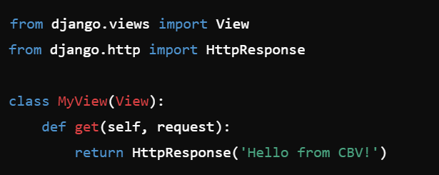
Class-Based Views (CBVs)
Definition
CBVs provide a structured way to handle views by using Python classes.
Example:
Leverages Object-Oriented Programming to reduce code duplication.

Slide 6
Common Class-Based Views
TemplateView: Renders HTML templates.
ListView: Displays a list of objects.
DetailView: Shows detailed view of a single object.
CreateView, UpdateView, DeleteView: Handle form submissions for creating, updating, and deleting objects.

Slide 7
CBV Advantages
More DRY (Don't Repeat Yourself) compared to FBVs.
Easier to scale and reuse logic with inheritance.
Built-in mixins for common functionality.

Slide 8
Task 2: Create a Class-Based View(15 Mins)
Create a CBV that displays a list of items from the database using ListView.

Slide 9
FBVs vs. CBVs
Feature | Function-Based Views | Class-Based Views
Simplicity | Easier to write for small logic | More structured, scalable
Reusability | Harder to reuse code | Promotes code reuse
Built-in Functionality | Minimal, relies on decorators | Offers many built-in mixins

Slide 10
Task 3: Refactor FBV to CBV (15 Mins)
Refactor the FBV from Task 1 into a CBV.

Slide 11
Conclusion
Both FBVs and CBVs have their own strengths.
Use FBVs for simple logic, and CBVs for scalable, reusable views.

Slide 12

Q&A Session

